Slide 1

Software-Defined Networking (SDN)

Slide 2

The Internet: A Remarkable Story
Tremendous success
From research experiment to global infrastructure
Brilliance of under-specifying
Network: best-effort packet delivery
Hosts: arbitrary applications
Enables innovation in applications
Web, P2P, VoIP, social networks, virtual worlds
But, change is easy only at the edge… ☹

Slide 3
The Internet: A Remarkable Story
Tremendous success
From research experiment to global infrastructure
Brilliance of under-specifying
Network: best-effort packet delivery
Hosts: arbitrary applications
Enables innovation in applications
Web, P2P, VoIP, social networks, virtual worlds
But, change is easy only at the edge… ☹

Slide 4
Inside the ‘Net: A Different Story…
Closed equipment
Software bundled with hardware
Vendor-specific interfaces
Over specified
Slow protocol standardization
Few people can innovate
Equipment vendors write the code
Long delays to introduce new features
Impacts performance, security, reliability, cost…

Slide 5



Networks are Hard to Manage
Operating a network is expensive
More than half the cost of a network
Yet, operator error causes most outages
Buggy software in the equipment
Routers with 20+ million lines of code
Cascading failures, vulnerabilities, etc.
The network is “in the way”
Especially a problem in data centers
… and home networks

Slide 6
SDN is a new approach to networking
Not about “architecture”: IP, TCP, etc.
But about design of network control (routing, TE,…)
Full Disclosure: SDN invented by Nicira Networks
Based on earlier work at Stanford, UCB, Princeton, CMU
But this is not a sales pitch for Nicira
Nicira sells products that happen to use SDN internally
It does not sell SDN, nor market itself as an SDN company

Slide 7
Status of SDN
Open Networking Foundation is standards body
SDN endorsed by 49 companies
Almost everyone who matters…..
A few products on market, many more coming
Some large companies using SDN internally
SDN has won the war of words, the real battle over customer adoption is just beginning….

Slide 8
Two Key Definitions
Data Plane: processing and delivery of packets
Based on state in routers and endpoints
E.g., IP, TCP, Ethernet, etc.
Fast timescales (per-packet)
Control Plane: establishing the state in routers
Determines how and where packets are forwarded
Routing, traffic engineering, firewall state, …
Slow time-scales (per control event)

Slide 9
The Future of Networking, and the Past of Protocols
Scott Shenker
Notes:
Martin’s role
Past is prologue
This talk is about the future, but we should first learn from the past

Slide 10
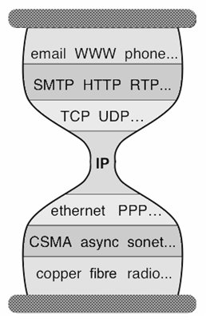
Key to Internet Success: Layers
Applications
…built on…
Reliable (or unreliable) transport
…built on…
Best-effort global packet delivery
…built on…
Best-effort local packet delivery
…built on…
Physical transfer of bits

Slide 11
Why Is Layering So Important?
Decomposed delivery into fundamental components
Independent but compatible innovation at each layer
A practical success of unprecedented proportions…
…but an academic failure

Slide 12
Built an Artifact, Not a Discipline
Other fields in “systems”: OS, DB, DS, etc.
Teach basic principles
Are easily managed
Continue to evolve
Networking:
Teach big bag of protocols
Notoriously difficult to manage
Evolves very slowly

Slide 13
Why Does Networking Lag Behind?
Networks used to be simple: Ethernet, IP, TCP….
New control requirements led to great complexity
Isolation ➔ VLANs, ACLs
Traffic engineering ➔ MPLS, ECMP, Weights
Packet processing ➔ Firewalls, NATs, middleboxes
Payload analysis ➔ Deep packet inspection (DPI)
…..
Mechanisms designed and deployed independently
Complicated “control plane” design, primitive functionality
Stark contrast to the elegantly modular “data plane”

Slide 14
Infrastructure Still Works!
Only because of “our” ability to master complexity
This ability to master complexity is both a blessing…
…and a curse!
Notes:
Network sysadmins….

Slide 15
simplicity vs Complexity
The ability to master complexity is not the same as the ability to extract simplicity
When first getting systems to work….
Focus on mastering complexity
When making system easy to use and understand
Focus on extracting simplicity
You will never succeed in extracting simplicity
If don’t recognize it is different from mastering complexity

Slide 16
What Is the point?
Networking still focused on mastering complexity
Little emphasis on extracting simplicity from control plane
No recognition that there’s a difference….
Extracting simplicity builds intellectual foundations
Necessary for creating a discipline….
That’s why networking lags behind

Slide 17
A Better Example: Programming
Machine languages: no abstractions
Mastering complexity was crucial
Higher-level languages: OS and other abstractions
File system, virtual memory, abstract data types, ...
Modern languages: even more abstractions
Object orientation, garbage collection,…
Abstractions key to extracting simplicity
Notes:
Interesting contrast. People who understand details of networks are still the recognized networking “experts”. But kernel hackers no longer king of coders. In fact, they have become somewhat anachronistic. Ruby on Rails programmers earn millions throwing together web services while kernel hackers live in their parents’ basement…..

Slide 18
“The Power of Abstraction”
“Modularity based on abstraction
is the way things get done”
− Barbara Liskov
Abstractions ➔ Interfaces ➔ Modularity
What abstractions do we have in networking?

Slide 19
Layers are Great Abstractions
Layers only deal with the data plane
We have no powerful control plane abstractions!
How do we find those control plane abstractions?
Two steps: define problem, and then decompose it.

Slide 20
The Network Control Problem
Compute the configuration of each physical device
E.g., Forwarding tables, ACLs,…
Operate without communication guarantees
Operate within given network-level protocol
Only people who love complexity would find this a reasonable request
Notes:
We think of this as normal. Everyone else thinks this is insanity!

Slide 21
Programming Analogy
What if programmers had to:
Specify where each bit was stored
Explicitly deal with all internal communication errors
Within a programming language with limited expressability
Programmers would redefine problem:
Define a higher level abstraction for memory
Build on reliable communication abstractions
Use a more general language
Abstractions divide problem into tractable pieces
And make programmer’s task easier
Notes:
Two separate issues:
Support abstractions: separation of concerns
Putting them together: programmer has less to do

Slide 22
From Requirements to Abstractions
Operate without communication guarantees
Need an abstraction for distributed state
Compute the configuration of each physical device
Need an abstraction that simplifies configuration
Operate within given network-level protocol
Need an abstraction for general forwarding model
Once these abstractions are in place, control mechanism has a much easier job!
Notes:
Why “distributed state”? Because the communication in control programs is ALL directed towards collecting/disseminating/or calculating on distributed state.
Tell you how later, but this is the purpose of the abstractions…

Slide 23
My Entire Talk in One Sentence
SDN is defined precisely by these three abstractions
Distribution, forwarding, configuration
SDN not just a random good idea…
Fundamental validity and general applicability
SDN may help us finally create a discipline
Abstractions enable reasoning about system behavior
Provides environment where formalism can take hold….
OK, but what are these abstractions?

Slide 24
1. Distributed State Abstraction
Shield control mechanisms from state distribution
While allowing access to this state
Natural abstraction: global network view
Annotated network graph provided through an API
Implemented with “Network Operating System”
Control mechanism is now program using API
No longer a distributed protocol, now just a graph algorithm
E.g. Use Dijkstra rather than Bellman-Ford

Slide 25
Traditional Computer Networks
Data plane:
Packet streaming
Forward, filter, buffer, mark,
rate-limit, and measure packets
Notes:
Maybe this is a better picture… though need some details of what happens in each plane… like in next slides… or, have both?

Slide 26
Traditional Computer Networks
Control plane:
Distributed algorithms
Track topology changes, compute routes, install forwarding rules
Notes:
Maybe this is a better picture… though need some details of what happens in each plane… like in next slides… or, have both?

Slide 27
Traditional Computer Networks
Management plane:
Human time scale
Collect measurements and configure the equipment
Notes:
Maybe this is a better picture… though need some details of what happens in each plane… like in next slides… or, have both?

Slide 28
Death to the Control Plane!
Simpler management
No need to “invert” control-plane operations
Faster pace of innovation
Less dependence on vendors and standards
Easier interoperability
Compatibility only in “wire” protocols
Simpler, cheaper equipment
Minimal software

Slide 29
Software Defined Networking (SDN)
Logically-centralized control
Smart,
slow
API to the data plane
(e.g., OpenFlow)
Dumb,
fast
Switches

Slide 30
Software Defined Network (SDN)
Traditional Control Mechanisms
Network of Switches and/or Routers
e.g. routing, access control
Control Program
Global Network View
Distributed algorithm running between neighbors
Network OS
Notes:
Project 2 would have been trivial: Dijkstra on a graph.

Slide 31
Major Change in Paradigm
No longer designing distributed control protocols
Design one distributed system (NOS)
Use for all control functions
Now just defining a centralized control function
Configuration = Function(view)
If you understand this, raise your hand.
Notes:
Stop. Does everyone get this. Unless I see everyone’s hands up, I am not going further.

Slide 32
2. Specification Abstraction
Control program should express desired behavior
It should not be responsible for implementing that behavior on physical network infrastructure
Natural abstraction: simplified model of network
Simple model with only enough detail to specify goals
Requires a new shared control layer:
Map abstract configuration to physical configuration
This is “network virtualization”
Notes:
Just like VMs. Virtualizing network with abstractions, rather than physical topology.

Slide 33
Simple Example: Access Control
What
Abstract Network
Model
Global
Network View
How
Notes:
What is access control?

Slide 34
Software Defined Network: Take 2
Abstract Network Model
Network Virtualization
Control Program
Global Network View
Network OS

Slide 35
What Does This Picture Mean?
Write a simple program to configure a simple model
Configuration merely a way to specify what you want
Examples
ACLs: who can talk to who
Isolation: who can hear my broadcasts
Routing: only specify routing to the degree you care
Some flows over satellite, others over landline
TE: specify in terms of quality of service, not routes
Virtualization layer “compiles” these requirements
Produces suitable configuration of actual network devices
NOS then transmits these settings to physical boxes

Slide 36
Software Defined Network: Take 2
Specifies behavior
Control Program
Abstract Network Model
Compiles to topology
Network Virtualization
Global Network View
Transmits to switches
Network OS

Slide 37
Two Examples Uses
Scale-out router:
Abstract view is single router
Physical network is collection of interconnected switches
Allows routers to “scale out, not up”
Use standard routing protocols on top
Multi-tenant networks:
Each tenant has control over their “private” network
Network virtualization layer compiles all of these individual control requests into a single physical configuration
Hard to do without SDN, easy (in principle) with SDN

Slide 38
3. Forwarding Abstraction
Switches have two “brains”
Management CPU (smart but slow)
Forwarding ASIC (fast but dumb)
Need a forwarding abstraction for both
CPU abstraction can be almost anything
ASIC abstraction is much more subtle: OpenFlow
OpenFlow:
Control switch by inserting <header;action> entries
Essentially gives NOS remote access to forwarding table
Instantiated in OpenvSwitch

Slide 39
Does SDN Work?
Is it scalable? Yes
Is it less responsive? No
Does it create a single point of failure? No
Is it inherently less secure? No
Is it incrementally deployable? Yes

Slide 40
SDN: Clean Separation of Concerns
Control program: specify behavior on abstract model
Driven by Operator Requirements
Net Virt’n: map abstract model to global view
Driven by Specification Abstraction
NOS: map global view to physical switches
API: driven by Distributed State Abstraction
Switch/fabric interface: driven by Forwarding Abstraction
Notes:
Clean separation of concerns; the modularity we were seeking
independent innovation, rich ecosystem, etc.
Innovation is the true value proposition of SDN!
by enterprises
by ecosystem as a whole….
There is a tie between abstractions and innovation, and between abstractions and science.

Slide 41
We Have Achieved Modularity!
Modularity enables independent innovation
Gives rise to a thriving ecosystem
Innovation is the true value proposition of SDN
SDN doesn’t allow you to do the impossible
It just allows you to do the possible much more easily
This is why SDN is the future of networking…

Slide 42
OpenFlow Networks

Slide 43

Data-Plane: Simple Packet Handling
Simple packet-handling rules
Pattern: match packet header bits
Actions: drop, forward, modify, send to controller
Priority: disambiguate overlapping patterns
Counters: #bytes and #packets
src=1.2.*.*, dest=3.4.5.* → drop
src = *.*.*.*, dest=3.4.*.* → forward(2)
3. src=10.1.2.3, dest=*.*.*.* → send to controller

Slide 44
Unifies Different Kinds of Boxes
Router
Match: longest destination IP prefix
Action: forward out a link
Switch
Match: destination MAC address
Action: forward or flood
Firewall
Match: IP addresses and TCP/UDP port numbers
Action: permit or deny
NAT
Match: IP address and port
Action: rewrite address and port

Slide 45
Controller: Programmability
Controller Application
Network OS
Events from switches
Topology changes,
Traffic statistics,
Arriving packets
Commands to switches
(Un)install rules,
Query statistics,
Send packets

Slide 46
Example OpenFlow Applications
Dynamic access control
Seamless mobility/migration
Server load balancing
Network virtualization
Using multiple wireless access points
Energy-efficient networking
Adaptive traffic monitoring
Denial-of-Service attack detection
See http://www.openflow.org/videos/

Slide 47

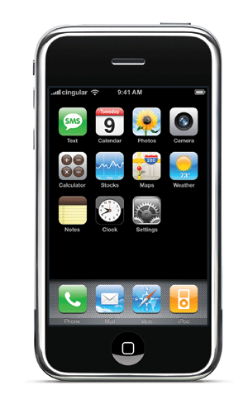
E.g.: Dynamic Access Control
Inspect first packet of a connection
Consult the access control policy
Install rules to block or route traffic

Slide 48
E.g.: Seamless Mobility/Migration
See host send traffic at new location
Modify rules to reroute the traffic

Slide 49
E.g.: Server Load Balancing
Pre-install load-balancing policy
Split traffic based on source IP
src=0*
src=1*

Slide 50
E.g.: Network Virtualization
Controller #1
Controller #2
Controller #3
Partition the space of packet headers

Slide 51
OpenFlow in the Wild
Open Networking Foundation
Google, Facebook, Microsoft, Yahoo, Verizon, Deutsche Telekom, and many other companies
Commercial OpenFlow switches
HP, NEC, Quanta, Dell, IBM, Juniper, …
Network operating systems
NOX, Beacon, Floodlight, Nettle, ONIX, POX, Frenetic
Network deployments
Eight campuses, and two research backbone networks
Commercial deployments (e.g., Google backbone)

Slide 52
A Helpful Analogy
From Nick McKeown’s talk “Making SDN Work” at the Open Networking Summit, April 2012

Slide 53
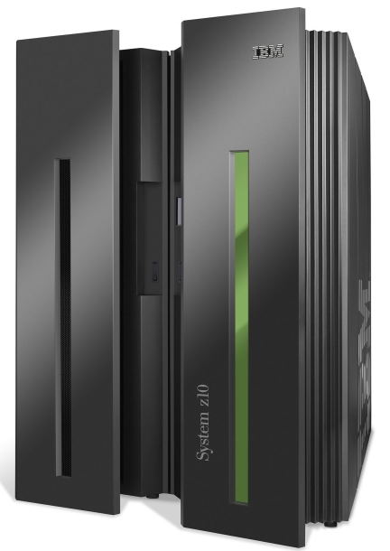
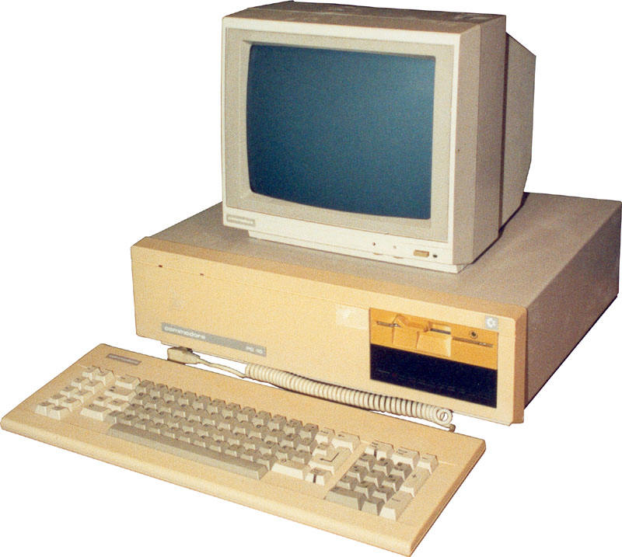
Mainframes
App
App
App
App
App
App
App
App
App
App
App
Specialized
Applications
Open Interface
Windows
(OS)
Linux
Mac
OS
Specialized
Operating
System
or
or
Open Interface
Specialized
Hardware
Microprocessor
Vertically integrated
Closed, proprietary
Slow innovation
Small industry
Horizontal
Open interfaces
Rapid innovation
Huge industry

Slide 54
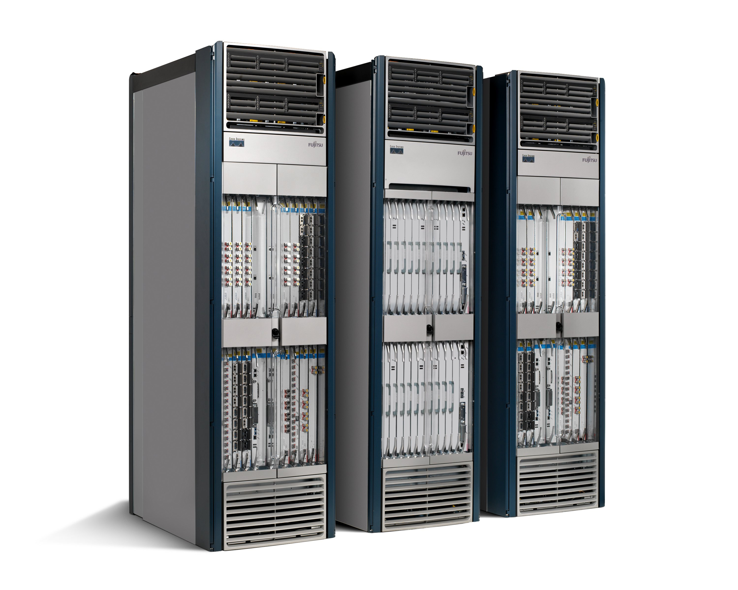
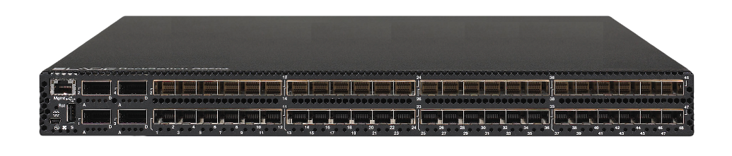
Routers/Switches
App
App
App
App
App
App
App
App
App
App
App
Specialized
Features
Open Interface
Control
Plane
Control
Plane
Control
Plane
or
or
Specialized
Control
Plane
Open Interface
Specialized
Hardware
Merchant
Switching Chips
Vertically integrated
Closed, proprietary
Slow innovation
Horizontal
Open interfaces
Rapid innovation

Slide 55
Challenges

Slide 56
Heterogeneous Switches
Number of packet-handling rules
Range of matches and actions
Multi-stage pipeline of packet processing
Offload some control-plane functionality (?)
access
control
MAC
look-up
IP
look-up

Slide 57
Controller Delay and Overhead
Controller is much slower the the switch
Processing packets leads to delay and overhead
Need to keep most packets in the “fast path”
packets

Slide 58
Distributed Controller
For scalability and reliability
Controller Application
Controller Application
Partition and replicate state
Network OS
Network OS

Slide 59
Testing and Debugging
OpenFlow makes programming possible
Network-wide view at controller
Direct control over data plane
Plenty of room for bugs
Still a complex, distributed system
Need for testing techniques
Controller applications
Controller and switches
Rules installed in the switches

Slide 60
Programming Abstractions
Controller APIs are low-level
Thin veneer on the underlying hardware
Need better languages
Composition of modules
Managing concurrency
Querying network state
Network-wide abstractions
Ongoing at Princeton
http://www.frenetic-lang.org/
Controller
Switches

Slide 61
Final Words
Future of networking lies in finding right abstractions
- The era of “a new protocol per problem” is over
Takes years to internalize and evaluate abstractions
-Even longer to adjust to software-oriented culture
We are in the early stages of an intellectual voyage
We should keep our minds open while charting our course

